Slide 1


Islamic Banking
In Sri Lanka
By
Azam Ameer
Head of Business
Amana Bank PLC – Sri Lanka

Slide 2
Islamic Banking has short history in Sri Lanka.
Sri Lanka is one of the few non-Islamic countries to have legislated for Islamic banking.
The revised Banking Act No 30 of 1988, as amended in 2005, allows both commercial banks and specialized banks to offer Islamic Banking products.
Introduced in 1997, local banks were venturing into the arena gradually and today there are state banks and commercial banks operating Islamic Banking activities

Slide 3






Islamic Banking in Sri Lanka
Demonstrate
Market Need & Viability
Secure Legal & Regulatory Acceptance
Demonstrate
Market Need & Viability
1997
1997
Changes to Banking Act
Universal
Proposition

Slide 4





Islamic Banking in Sri Lanka
1
Fully Fledged Islamic Bank
2
Windows owned by state banks
14
Windows owned by private banks
4
1 fully fledged and 3 windows offering Takaful

Slide 5
Islamic Banking in Sri Lanka
Key challenges faced in establishing the industry
Educating and convincing the regulators on the industry in a non Muslim country .
Educating and making awareness to the core market .
Private placement and then IPO before the listing in CSE
Setting the products and raising low cost funds with completion in the market with the conventional banks
Meeting regulatory requirements and assuring 100% compliance

Slide 6

One and only Islamic Bank in Sri Lanka

Slide 7




Overview of Amana Bank PLC
Strategic Shareholders
Legal Form
A Public Limited Liability Company incorporated in Sri Lanka under the Companies Act No. 07 of 2007
License
Licensed as a Commercial Bank under the Banking Act No. 30 of 1988 by the Central Bank of Sri Lanka.
Core Business
First and only fully fledged Islamic Bank in Sri Lanka, operating since 2011
Listing
Listed on the Main Board of the Colombo Stock Exchange (CSE)
IPO January 2014/ Rights Issuance 2017
IsDB & ICD 29.97%
KASSIM FAMILY
(FOUNDERS)
10.2%
7.2%
6.3%

Slide 8
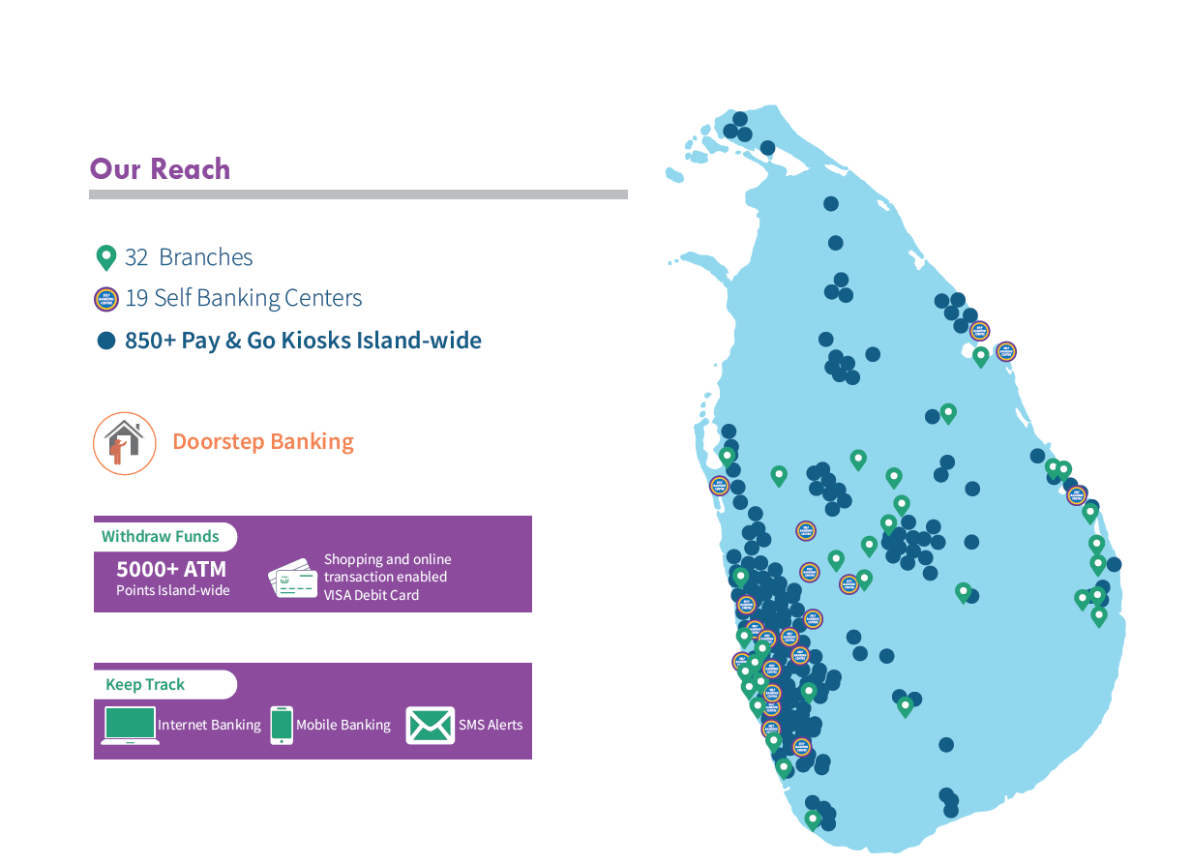
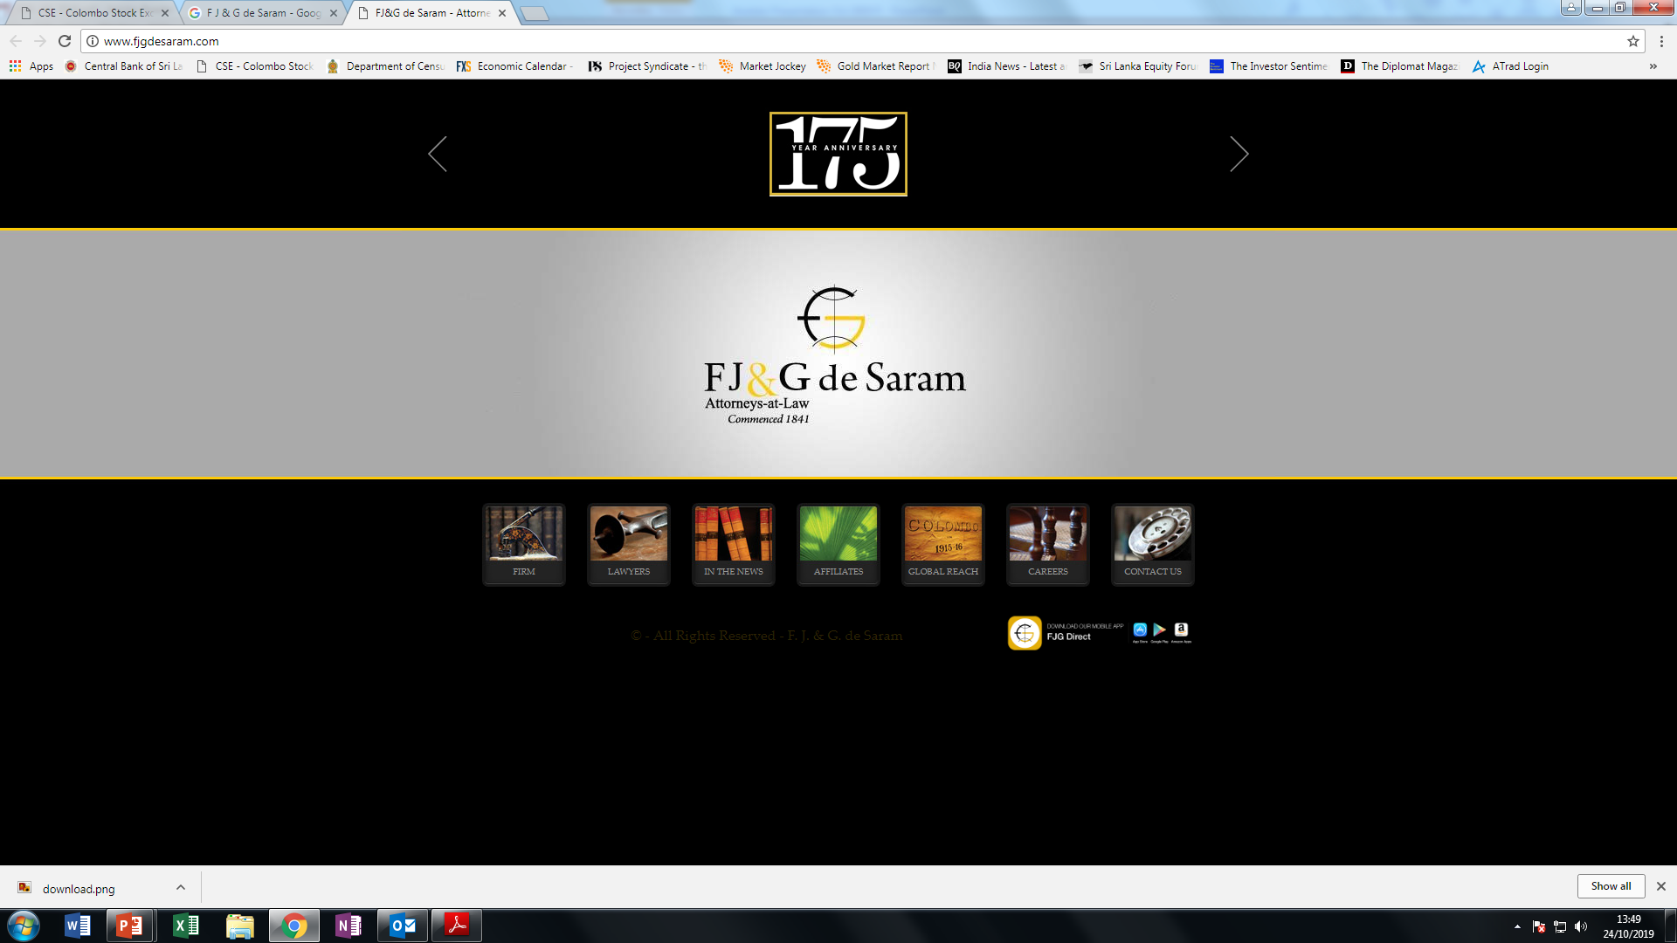




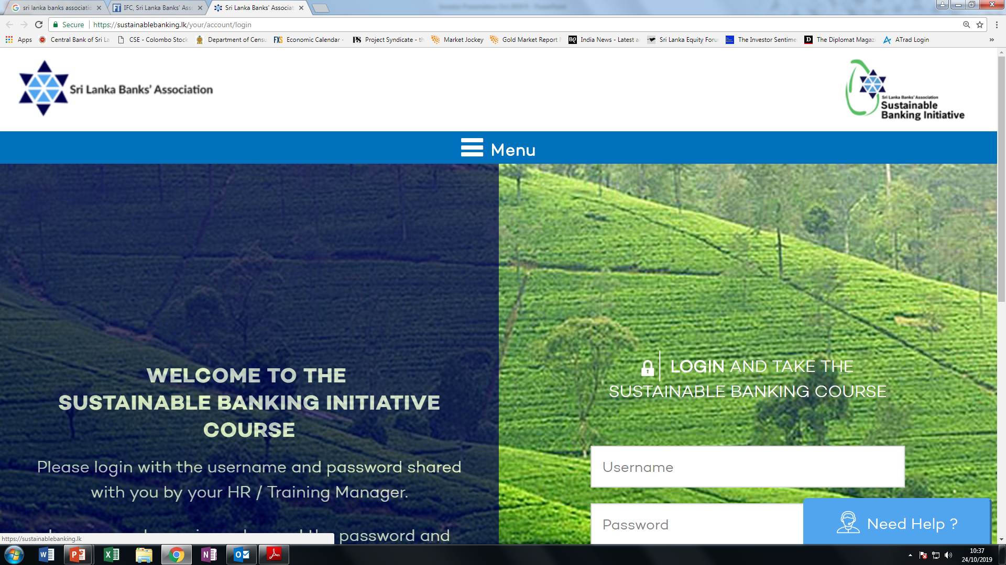
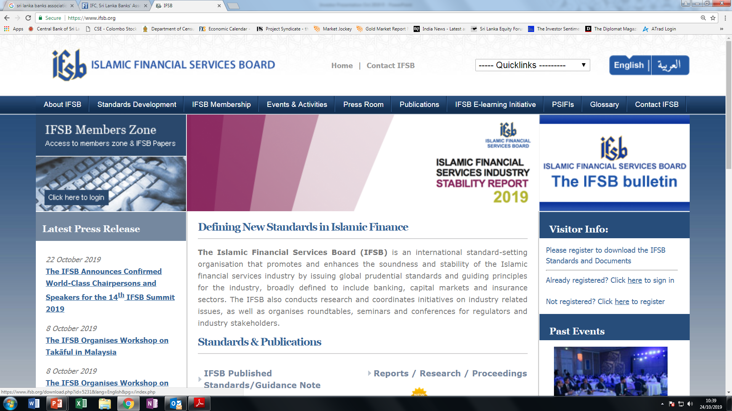
Overview of Amana Bank PLC
Lawyers
FJ&G de Saram -- Attorneys at Law
Ratings
Auditors
Long Term Rating | Outlook
BB+(lka) | Stable
Ernst & Young
Industry Memberships

Slide 9








Amana Bank PLC
Customers & Reach
66,380
380,000+
1
30
Customers
2011
NOW
Gold Safe
Keeping Units
2014
NOW
14
32
500
5,000+
Branches
2011
NOW
ATM Access
2012
NOW
1
19
1
900+
Self Banking Centres
(Digital)
2017
NOW
CDM Access
2017
NOW
1
8
15,230
105,000+
Ladies Units
2011
NOW
Debit Cards
2014
NOW

Slide 10
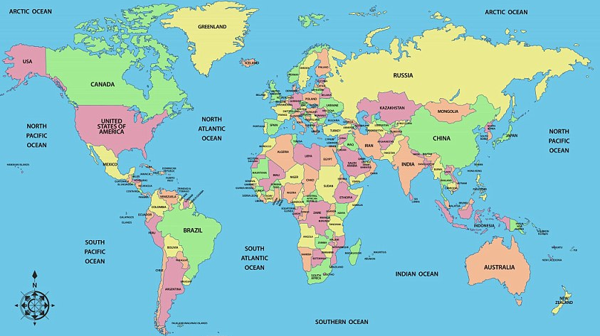








ii. Overview: Amana Bank PLC
International Reach
Country | No of Banks
BAHRAIN | 2
BANGLADESH | 1
BRUNEI | 1
CHINA | 2
EGYPT | 1
GERMANY | 2
HONG | 2
INDIA | 5
INDONESIA | 1
IRAQ | 1
ITALY | 1
JAPAN | 1
KOREA | 1
KUWAIT | 1
MALAYSIA | 3
MALDIVES | 2
OMAN | 1
PAKISTAN | 3
QATAR | 4
SAUDI | 1
SINGAPORE | 3
SWITZERLAND | 1
THAILAND | 1
TURKEY | 3
UAE | 9
UK | 3
USA | 4
◉
◉
◉
◉
◉
◉
◉
◉
◉
◉
◉
◉
x
◉
◉
◉
◉
India
◉
◉
◉
◉
◉
◉
◉
◉
◉
◉
◉
◉
Trade and Supply Chain Finance Program (TSCFP)

Slide 11
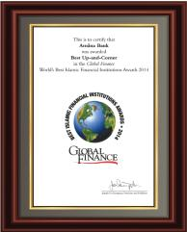


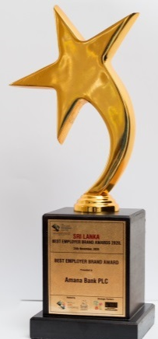


Awards & Accolades
Local, Regional and International Recognition
11th
Global Finance Awards USA
Best Up-and-Coming
Islamic Bank of the World
Global Banking & Finance UK
Fastest Growing Retail
Bank in Sri Lanka
IFFSA Awards
Best Islamic Bank
In South Asia
LMD
Most Awarded
Companies in Sri Lanka
80th
Brand Finance
Most Valuable Brands
In Sri Lanka
The Banker USA
Best Islamic Bank
In Sri Lanka
Global Finance Awards USA
Global Innovation
Award
IRB Awards Oman
Social Responsible
Bank of the Year
World HRD Congress
Best Employer Brand
Sri Lanka

Slide 12





Outlook
Sustain Core Banking Focus on SME & Consumer
Digital Transformation
Regional Expansion
Knowledge Marketing
Sustainable Banking

Slide 13



OrphanCare
Have you ever considered
what happens to an orphan
once they reach the age of 18?
Launch Event
Video
From Chance
to Choice Video

Slide 14

Thank you

